Slide 1
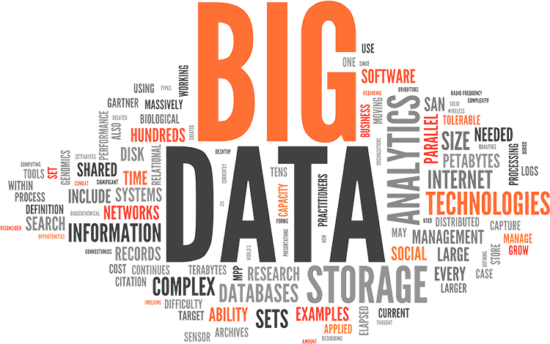

Slide 2
Agenda
What & Why
Where it Fits
Trend of Bigdata
Approach
3 V’s
Technical Landscape
Typical Solutions
<number>

Slide 3
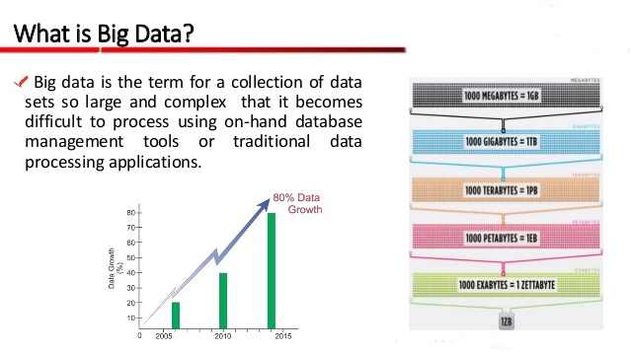
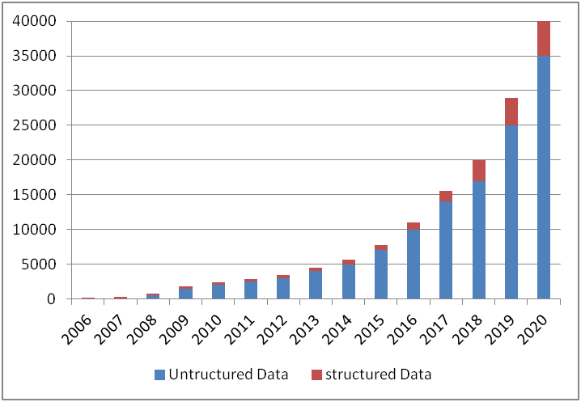
What & Why
<number>

Slide 4
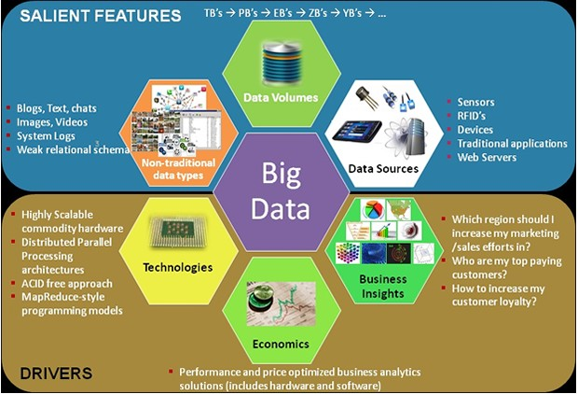
Where it Fits?
<number>

Slide 5
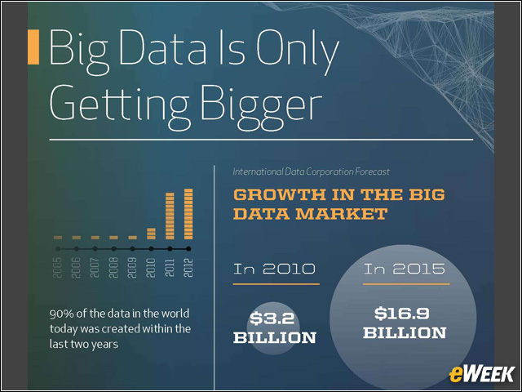
Trend of Bigdata
<number>

Slide 6
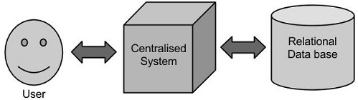
Approach
Traditional Approach
Google introduced an algorithm called Map Reduce.
This algorithm divides the task into small parts and assigns those parts to many computers and forms the final result dataset.
Doug Cutting, Mike Cafarella and team took the solution provided by Google and started an Open Source Project called HADOOP in 2005.
Hadoop runs applications using the Map Reduce algorithm, where the data is processed in parallel on different CPU node.
<number>

Slide 7
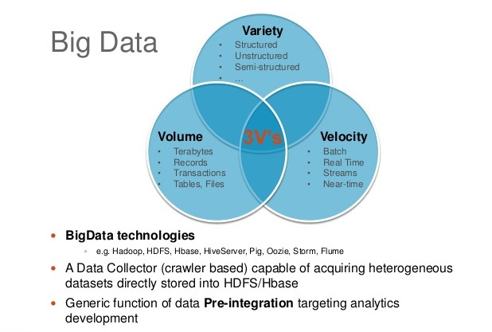
3 V’s
<number>

Slide 8

































Technical Landscape
Technical Area |  | Technology Name
Frameworks / Technologies
Streaming and Peripheral Technologies
Hadoop Distributors and Technologies
NoSQL DB
Analytics
<number>

Slide 9
Typical Solutions
Historical trend Analysis and Batch Analytics
Real-time Batch Analytics
Real-time Event Processing
Forecast and Predictions
Enterprise View Consolidation
Mass Personalization & Recommendations
Bigdata Batch Analytics
Machine Learning & Predictive Analysis
Real-time Batch and Event Processing
M2M Integration
Graph Analysis
Real-time Stream Processing
<number>

Slide 10
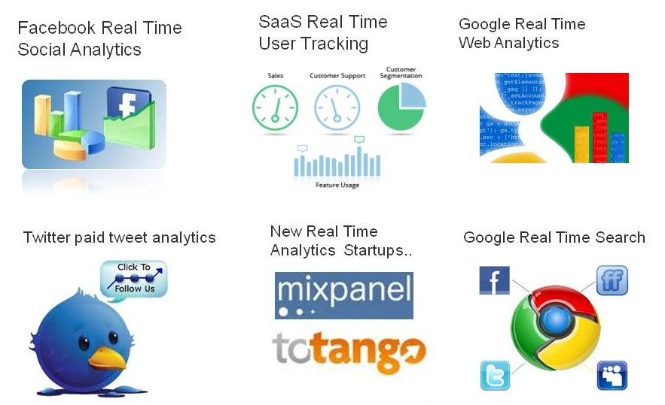
Who are ALL in this World
<number>

Slide 11
Questions?

